Slide 1
Tribal Consultation April 10, 2019
Steve Sisolak Governor
Suzanne Bierman, JD, MPH
Administrator
Division of Health Care Financing and Policy

Slide 2
Telepharmacy Options
Telepharmacy allows pharmacists to communicate with pharmacy technicians at remote sites with audio visual networks
Pharmaceutical vending machines may also be an option
Would allow pharmacy options for rural or underserved locations.
Several states have expanded state law to include telepharmacy including Alaska, Idaho, Illinois, Montana, South Dakota, Texas, Utah, Vermont and Wyoming

Slide 3
Youth Residential Treatment Centers
CMS has provided guidance that California allows for a YRTC to bill for two encounters per day per recipient
DHCFP has followed up with both the YRTC and the Medi-Cal to determine that mechanism or policy that supports this billing and is awaiting a response

Slide 4
Durable Medical Equipment
The tribal clinics have requested the consideration of DME as a billable encounter under PT 47
DHCFP is awaiting guidance from CMS related to this issue

Slide 5
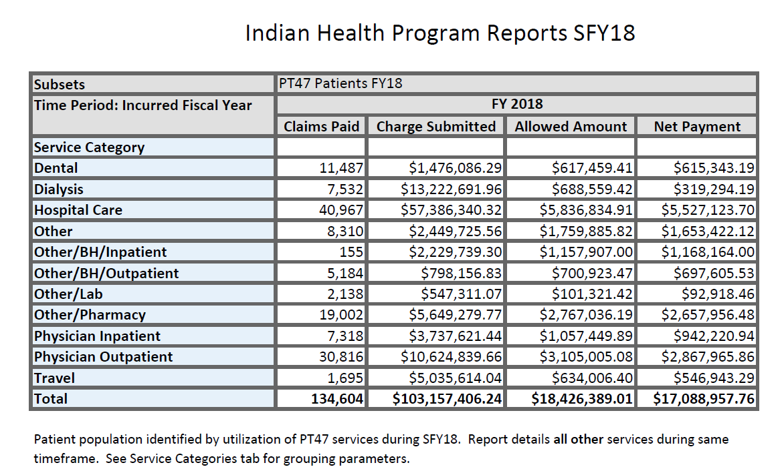
Provider Type 47 expenditures
The following chart represents expenditures that occur for patients identified as receiving services under PT 47 and also access services outside of the tribal clinic

Slide 6
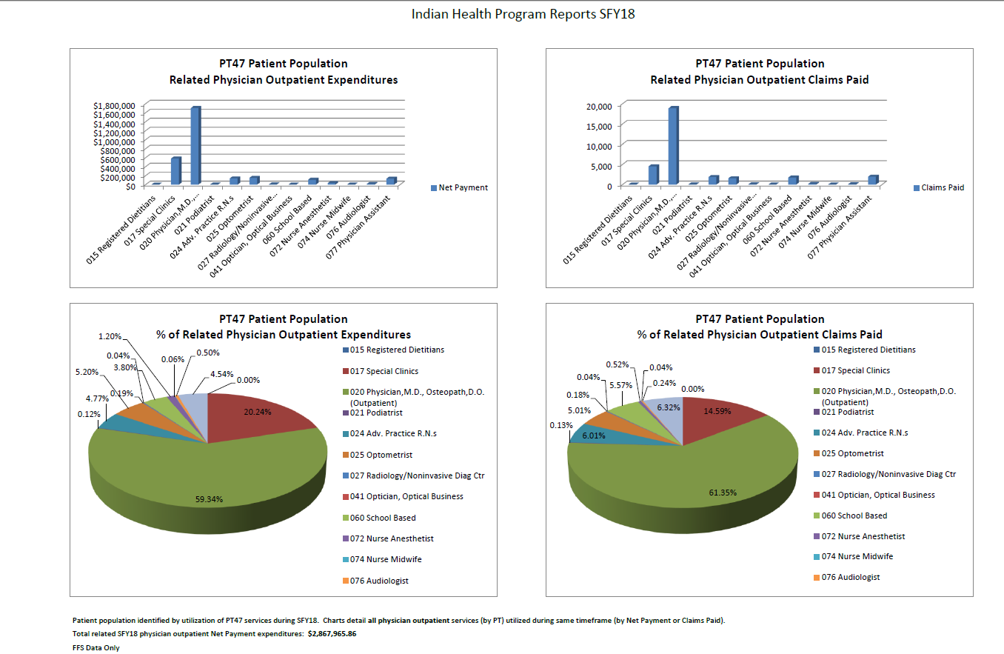

Slide 7
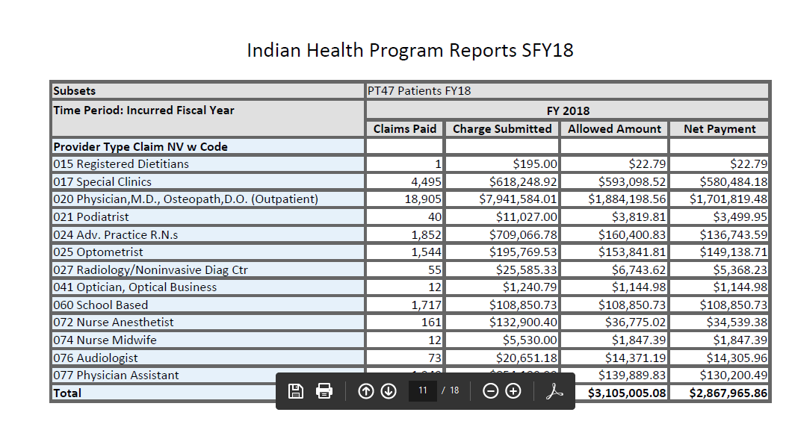
PT 47 – Physician Services Outside of the Tribal Clinic

Slide 8
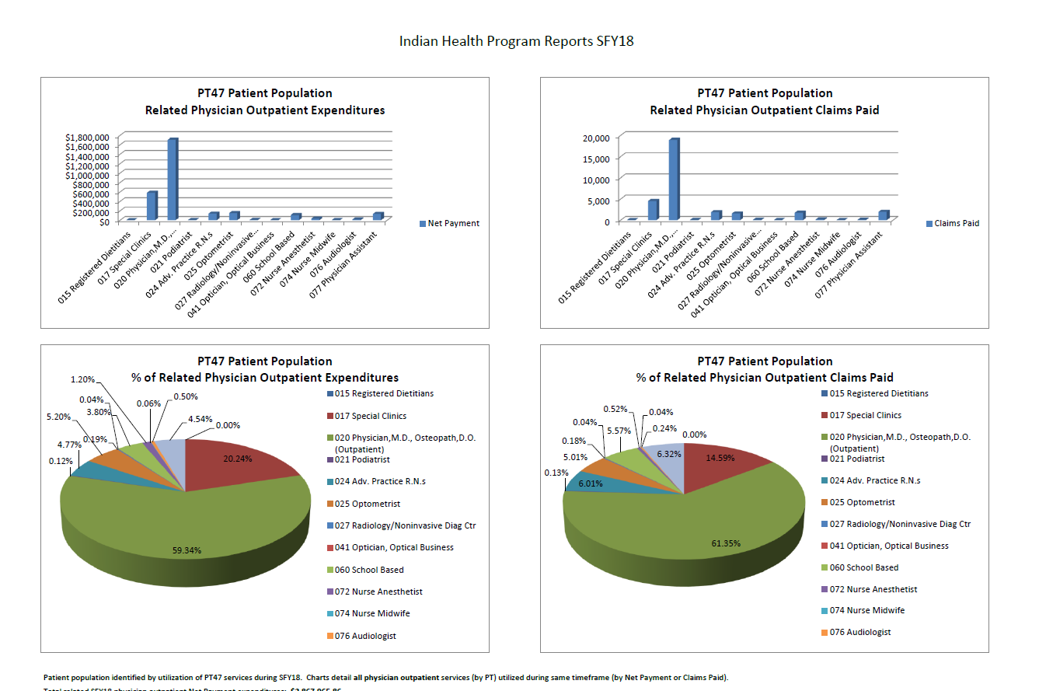

Slide 9
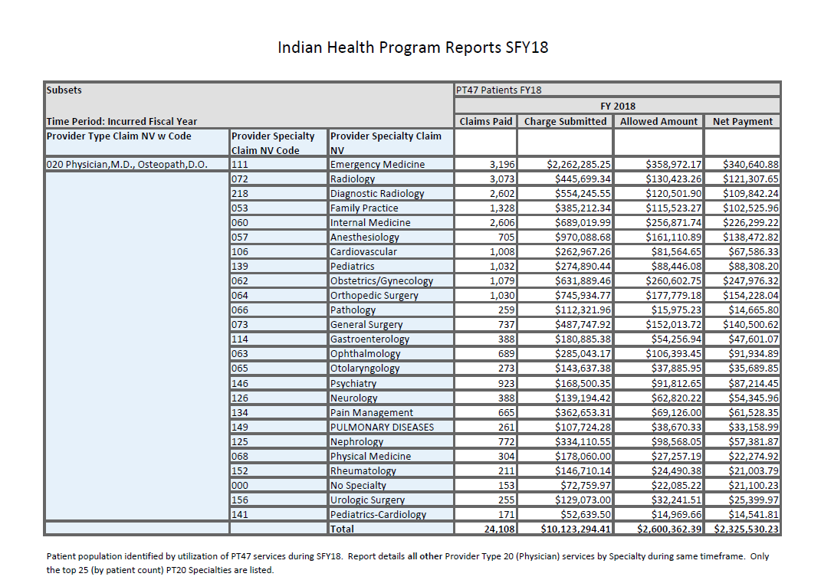

Slide 10
Tribal Administrative Claiming
DHCFP continues to explore options for Tribal Administrative Claiming
MAC allows government agencies to receive reimbursement for administrative activities, such as outreach and referral
The goal is increase retention and enrollment of AI/AN recipients in Medicaid
California and Washington tribes participate in a random moment time study (RMTS)
Alaska tribes provide an attestation of outreach and enrollment activities with an invoice attestation.
TMAC is eligible for 50% federal match. Tribes would establish an intergovernmental transfer with the state to forward the non federal share through which the state could draw down the federal share
Nevada will continue to conduct research and provide a in depth comparison of the states participating in TMAC to determine the feasibility for the state

Slide 11
AI/AN Medical Homes
Arizona Medicaid has added an option for American Indian Medical Homes (AIMH)
AIMH supports Primary Care Case Management (PCCM), diabetes education, and care coordination for enrolled members
AIMH addresses health disparities between American Indian and other populations in Arizona by enhancing case management.

